Slide 1

Digital Portfolio
STUDENT NAME: B.YOGALAKSHMI
REGISTER NO AND NMID: astvu36336324u09100
DEPARTMENT: BACHELOR OF COMPUTER SCINCE
COLLEGE: COLLEGE/ UNIVERSITY:SREE ABIRAAMI ARTS AND SCIENCE COLLEGE FOR WOMEN/THIRUVALLUVAR UNIVERSITY

Slide 2

AGENDA
Problem Statement
Project Overview
End Users
Tools and Technologies
Portfolio design and Layout
Features and Functionality
Results and Screenshots
Conclusion
Github Link
3/21/2024 Annual Review

Slide 3
PROJECT TITLE
DIGITAL PORTFOLIO

Slide 4
PROBLEM STATEMENT
🔥 Students struggle to showcase their full skills and achievements using only traditional Resumes or paper portfolios.
🧱 Static formats limit creativity and fail to engage viewers like teachers and r Recruiters.
📉 Many students lack an easy, modern way to present projects and extracurricular activities online.
🌍 In today’s digital world, a responsive and interactive portfolio is essential for effective self-presentation.
🛠️ There is a need for a simple, customizable digital portfolio built with web technologies like HTML, CSS, and JavaScript.

Slide 5
PROJECT OVERVIEW
5
🌟 In today’s education and job world, students need to show more than just a resume.​
​
📱 Recruiters, teachers, and collaborators look for a strong digital presenc​
​
​
💡They want to see students’ technical creativity.​
​
🛠️ Projects and hands-on work are important to prove skills.​
​
🎯 A traditional paper resume is no longer enough to impress.​

Slide 6
WHO ARE THE END USERS?
🌸 Students – Create and use the portfolio to show their skills, projects, and achievements.
🌼 Teachers – Review student work to understand progress and give feedback.
🌺 Employers/Recruiters – Check student portfolios when offering jobs or internships.
🌻 Other Students – View each other’s work for ideas or collaboration.
🌹 Parents – See their child’s achievements and progress.

Slide 7
TOOLS AND TECHNIQUES
💻 HTML – Builds the basic structure of your portfolio.
🎨 CSS – Adds style, colors, fonts, and layout.
⚙️ JavaScript – Adds interactivity like buttons and sliders.
📝 Code Editor – Used to write code (e.g., VS Code).
🌐 Web Browser – Used to test and view your website.
🗂️ Version Control (Git/GitHub) – Tracks changes in your code.

Slide 8
POTFOLIO DESIGN AND LAYOUT
Layout
🌟 Header
Your name and a short introduction.
A photo or avatar.
Easy-to-use menu for navigation.
📖 About Me
A few sentences about yourself.
Your education and hobbies.
💪 Skills
List your skills with icons or bars.
Group similar skills together.
8

Slide 9
FEATURES AND FUNCTIONALITY
🦸‍♂️ Function → A little superhero block of code that saves the day by doing one specific task.
☕ In Java → it wears the name tag method and lives inside a class.
📜 In JavaScript → it can roam free as a standalone hero, running logic wherever needed.
🎭 Functionality → The “superpowers” of a system or app — all the cool tricks, features, and tasks it can perform.

Slide 10
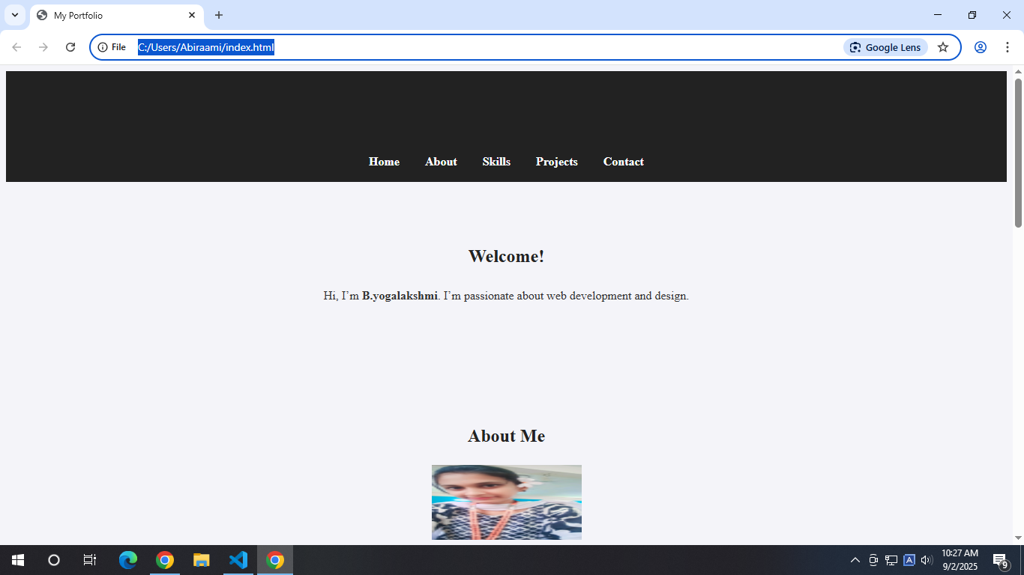
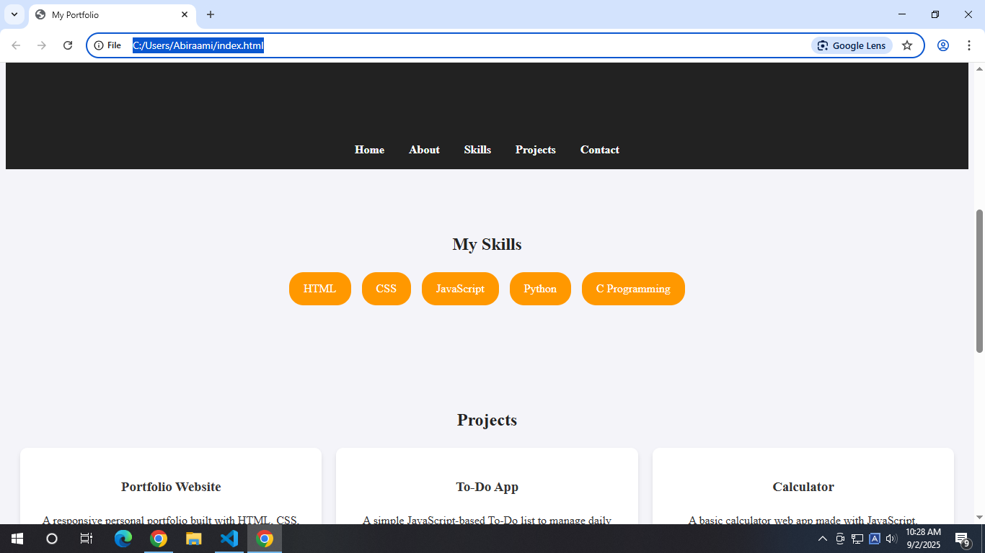
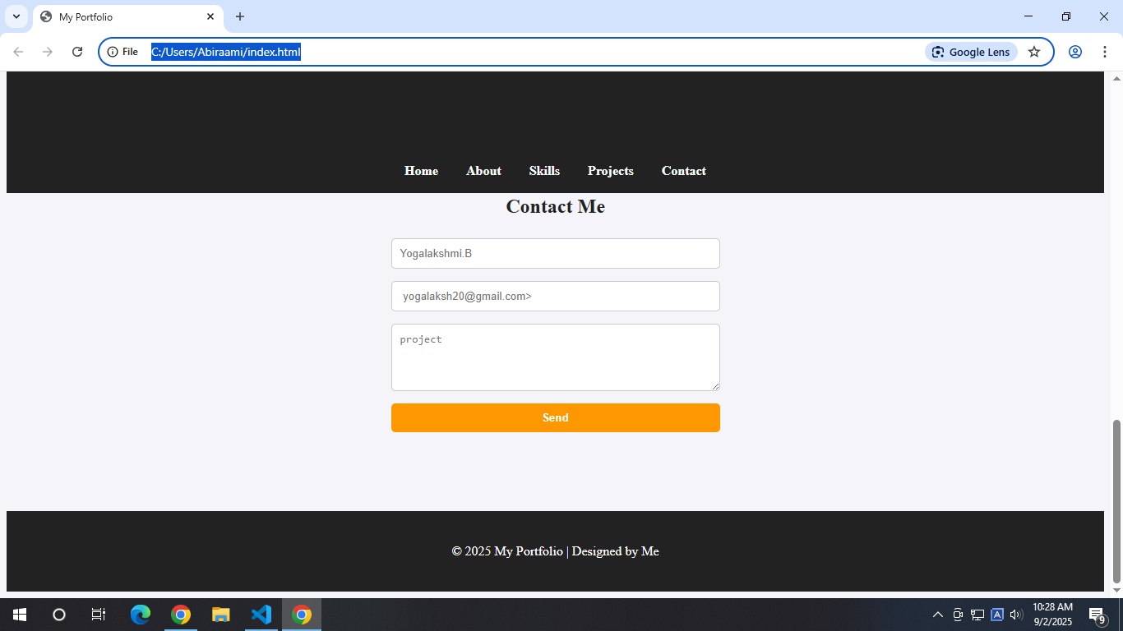
RESULTS AND SCREENSHOTS
10

Slide 11
CONCLUSION
🏗️ Built a solid foundation in web development with HTML and CSS — basically learned how to make the internet look less like a Word document.
🤯 Explored Java programming — broke my brain a few times, but came out smarter (and with fewer bugs… hopefully).
🎨 Showcased projects that are interactive and responsive — so users won’t need a magnifying glass or a supercomputer to view them.
⚡ Applied coding to real-world scenarios — because “Hello World” can only take you so far in life.
11

